Slide 1

Building Intelligent Applications with LangChain and LLMs
Tfug Ml MUMBAI meetup – July edition

Slide 2
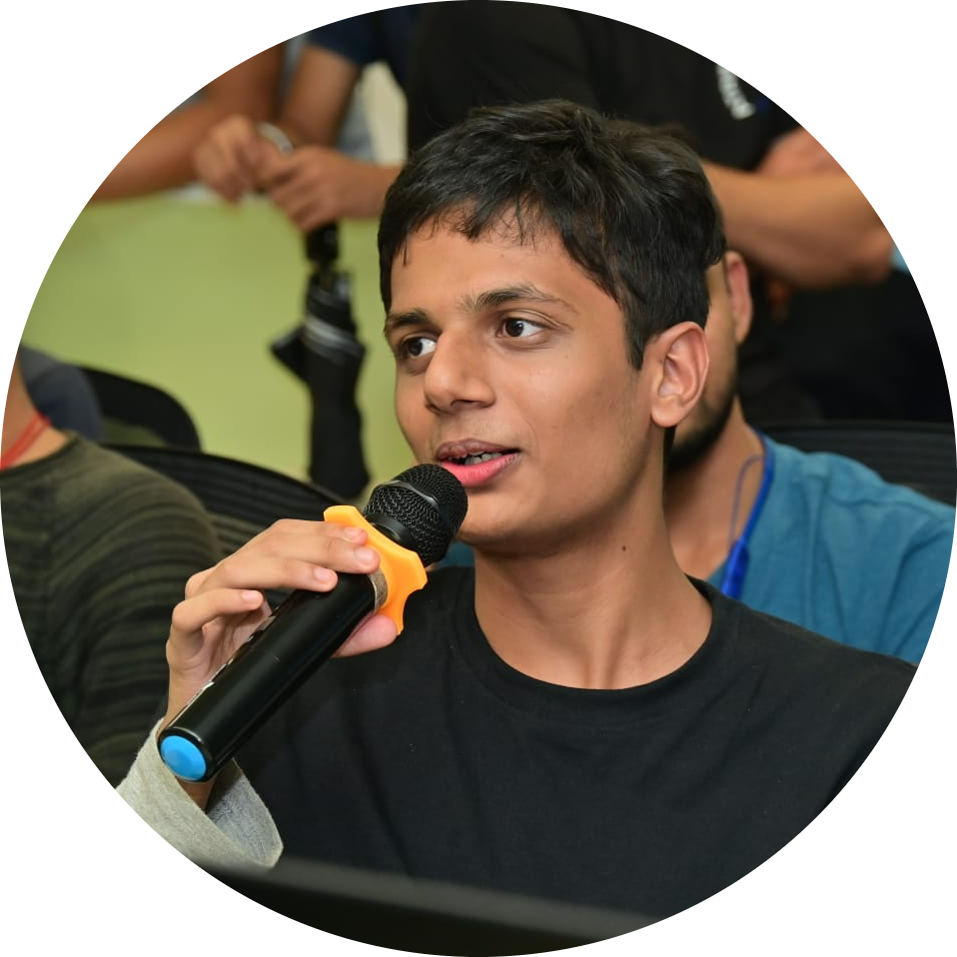
About Myself
Research Assistant at IIT Patna, Mandi, Jodhpur, Dhanbad, DRDO and KCL London
Research Head at DJSACM
Researcher in Natural Language Processing and AI
Full Stack Developer
5x Professional Speaker now 6x :)
Final Year Student at DJ Sanghvi College of Engineering

Slide 3
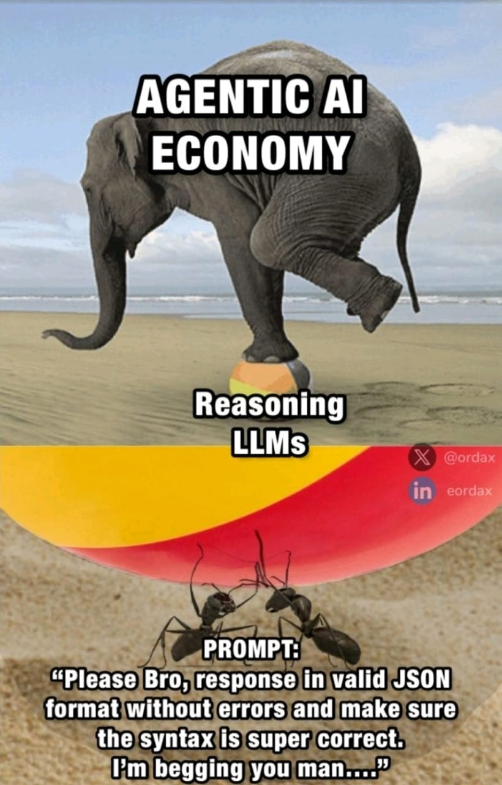
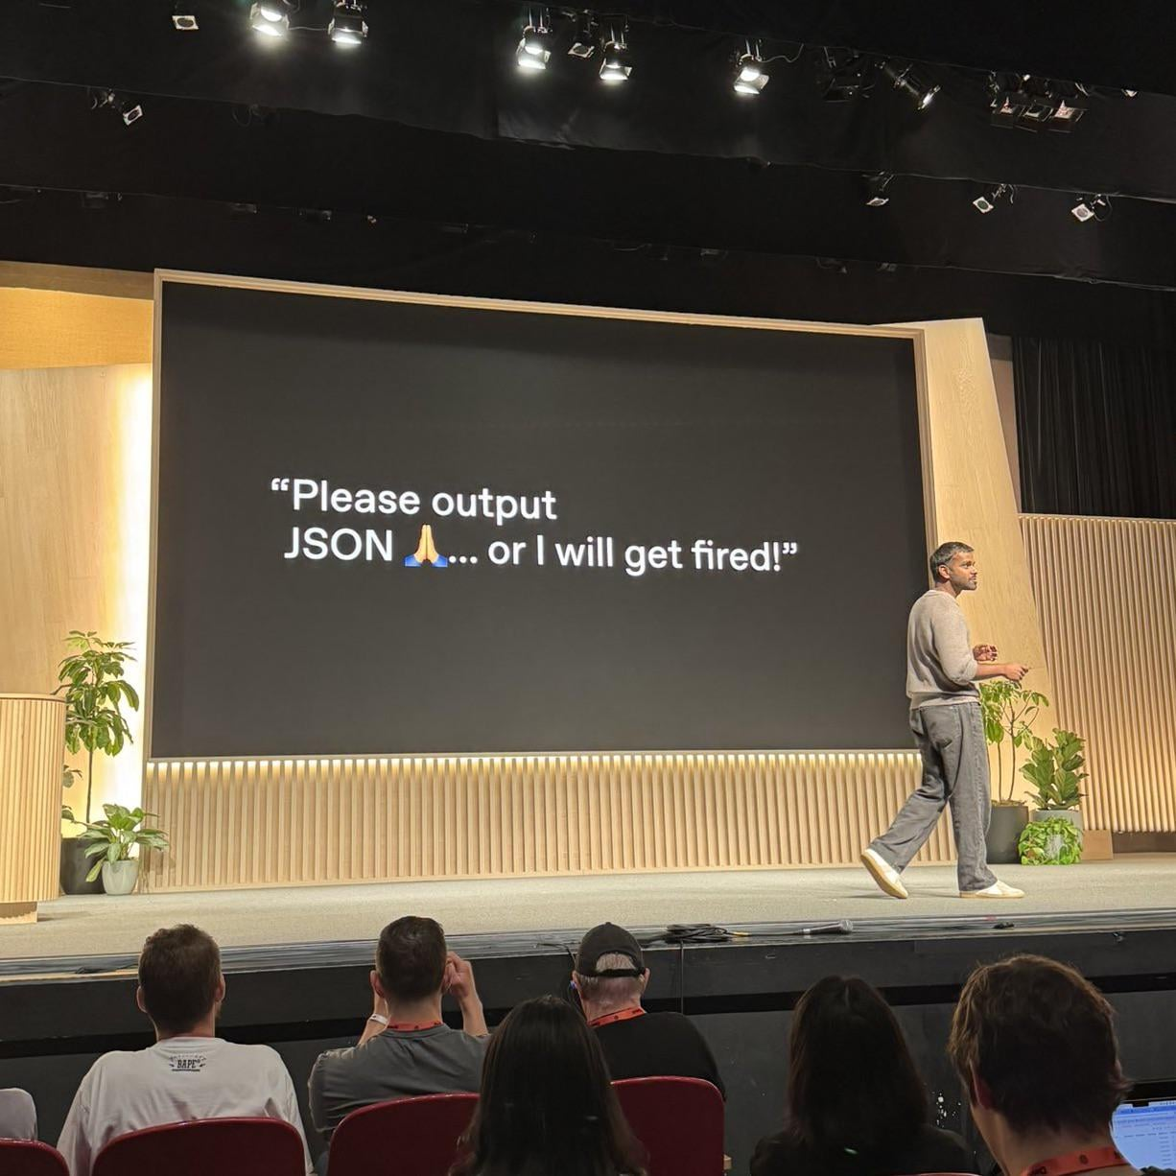
Why am I giving this talk?

Slide 4

LangChain
A Python framework to build applications powered by LLMs
Manage prompts, memory, chains, tools, and agents
Ideal for chatbots, document Q&A, agents, and more
Abstracts complexity of calling LLMs repeatedly
Easy chaining of tasks and reasoning steps
Built-in support for structured outputs (e.g., Pydantic, JSON)

Slide 5
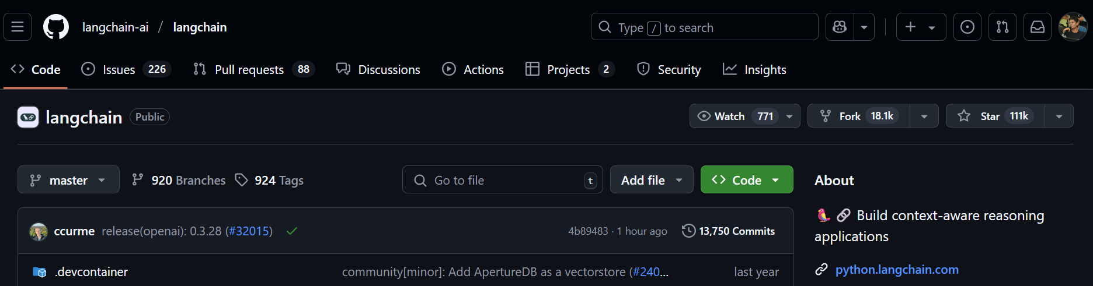
Why LangChain?
pip install langchain
npm install langchain
Popular Alternatives : LlamaIndex, Haystack

Slide 6

Tutorial
https://github.com/MihirRajeshPanchal/ml-mumbai
bit.ly/tfugmumbai

Slide 7


Connect me on
LinkTree
Portfolio

